Slide 1
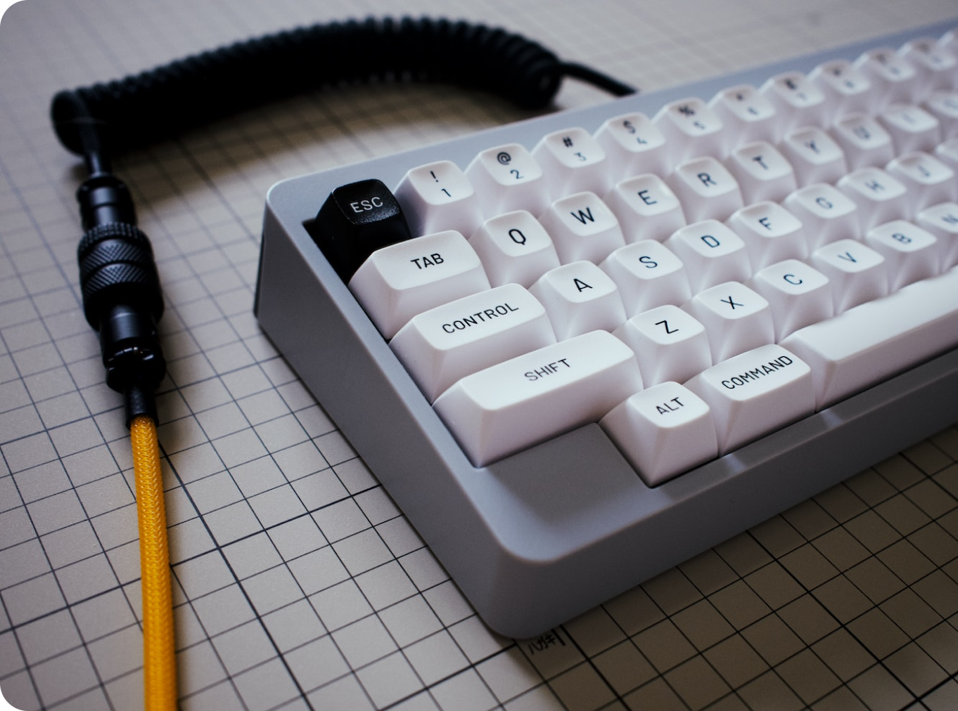





Home
Catalog
Resources
Find your Style
Introducing the best way to track up and coming group buys.
search
Search
Interest Checks
Product Name
Product Name
Product Name
Product Name
Product Name
2022
2022
2022
2022
2022
Current Group Buys
Product Name
Product Name
Product Name
Product Name
Product Name
Product Name
2022
2022
2022
2022
2022
2022
LIVE GROUP BUYS
Product Name
Product Name
Product Name
Product Name
2022
2022
2022
2022
Product Name
Product Name
Product Name
Product Name
2022
2022
2022
2022
FIND MORE
LOGO NAME
Search
Contact Us
Vendors
Terms of Service
Keyboards
Privacy Policy
© 2022 COMPANY NAME
Prices are in US Dollars (USD)
Switches

Slide 2



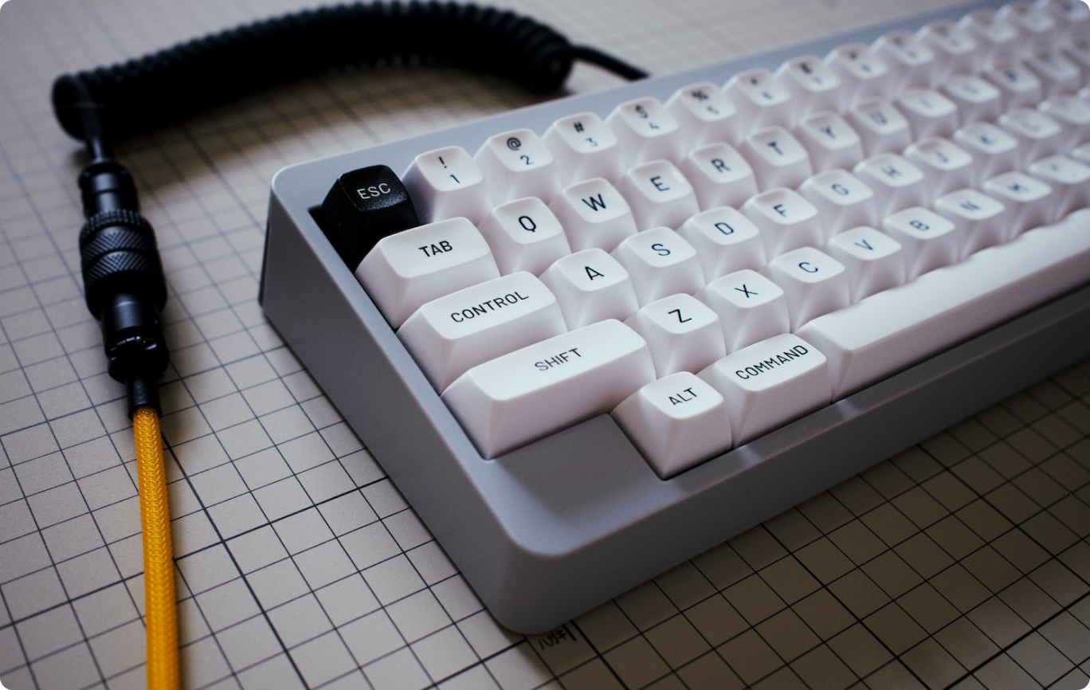




Home
Catalog
Resources
ALL
KEYBOARDS
NIMBUS
Nimbus
DELIVERING
Start Date
End Date
21st Feb 2022
24th Mar 2022
Brand
Profile
GMK
Cherry
Material
Designer
ABS
Scott L
Interest Check
Vendors
KBDFans
FancyCustoms
CannonKeys
SwagKeys
MyKeyboard
Kits
Base
Novelties
Spacebars
Mouse Pad
LOGO NAME
Search
Contact Us
Vendors
Terms of Service
Keyboards
Privacy Policy
© 2022 COMPANY NAME
Prices are in US Dollars (USD)
Switches

Slide 3

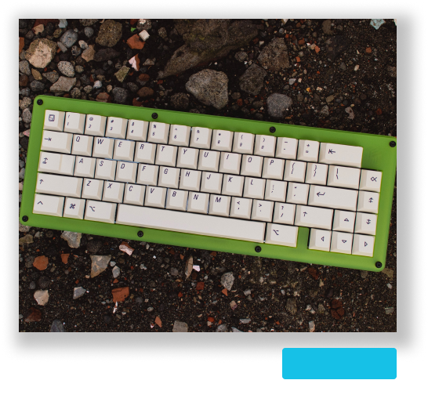
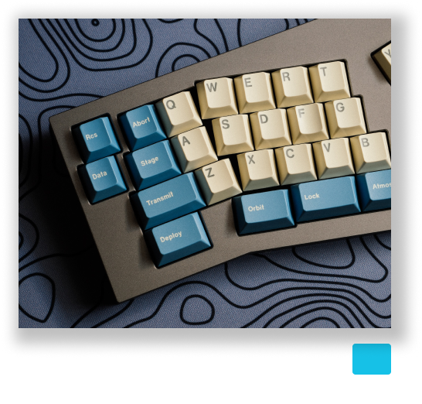
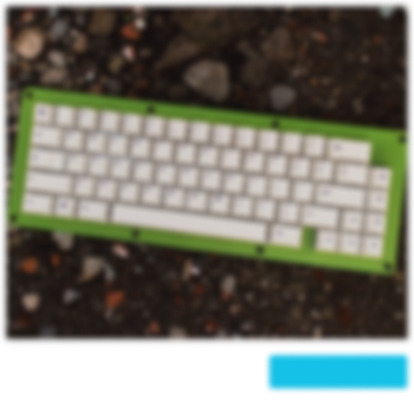
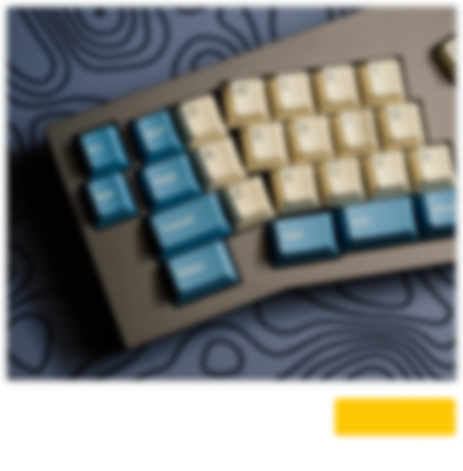
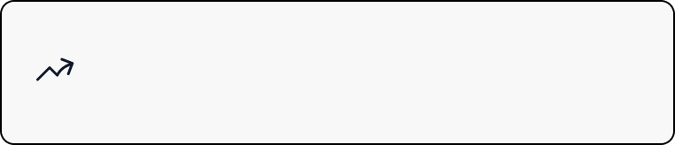

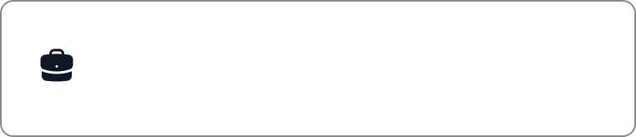

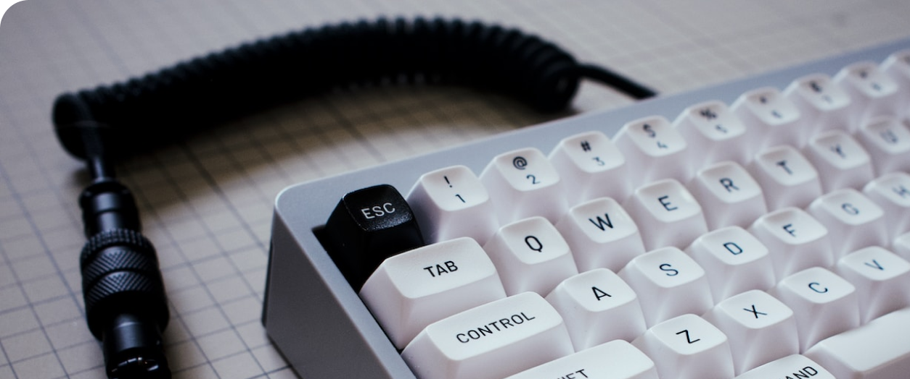
Sign up to Key Keeper
The best place to find and start your newest Group Buy.
GMK
Nimbus
SHIPPING
I want more Keyboards
GMK
Nimbus
2022
IC
Gotta feed the addiction somehow.
2022
GMK
Nimbus
GB ENDED
I want to share my creations
GMK
Nimbus
2022
GB WAIT
Gotta feed the addiction somehow.
2022
Already have an account?
Log in

Slide 4




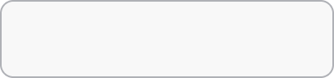
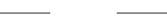
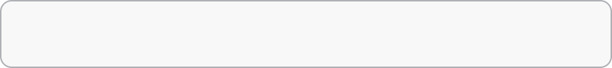

Create Account
or
GMK
Nimbus
SHIPPING
First Name
Last Name
GMK
Nimbus
2022
IC
Username
2022
GMK
Nimbus
GB ENDED
Email
GMK
Nimbus
2022
GB WAIT
Password
2022
I agree to the Terms and Privacy Policy.
Already have an account?
Log in

Slide 5

Log In
GMK
Nimbus
SHIPPING
or
GMK
Nimbus
2022
IC
Email
2022
GMK
Nimbus
GB ENDED
Password
GMK
Nimbus
2022
GB WAIT
2022
Don’t have an account yet?
Create an account!

Slide 6
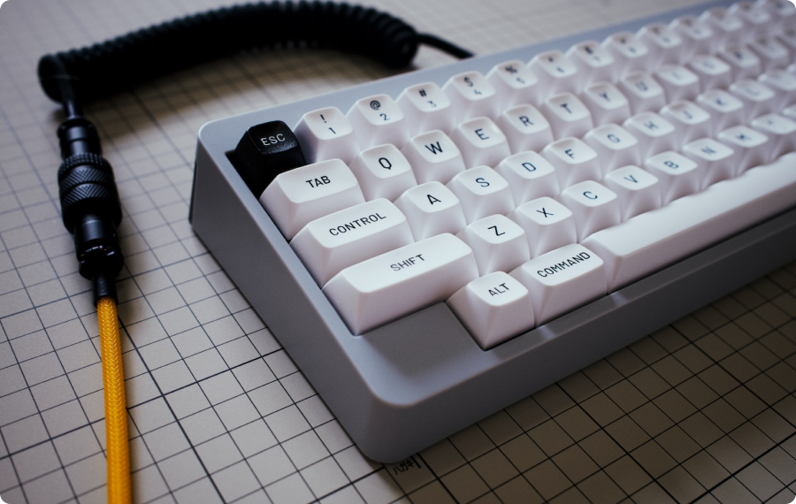


Nimbus
1 of 9
What do you think of the set?
Text Input: This set is garbage.
PlaceHolder: I think this is great!
SKIP
Next
© 2022 COMPANY NAME
By filling this form, you agree to the Terms.

Slide 7

Home
Catalog
Resources
search
Search
Brand
chevron-down
Material
chevron-down
Profile
chevron-down
Ascending
chevron-down
Sort
chevron-down
Product Name
Product Name
Product Name
Product Name
2022
2022
2022
2022
Product Name
Product Name
Product Name
Product Name
2022
2022
2022
2022
Product Name
Product Name
Product Name
Product Name
2022
2022
2022
2022
LOGO NAME
Search
Contact Us
Vendors
Terms of Service
Keyboards
Privacy Policy
© 2022 COMPANY NAME
Prices are in US Dollars (USD)
Switches

Slide 8





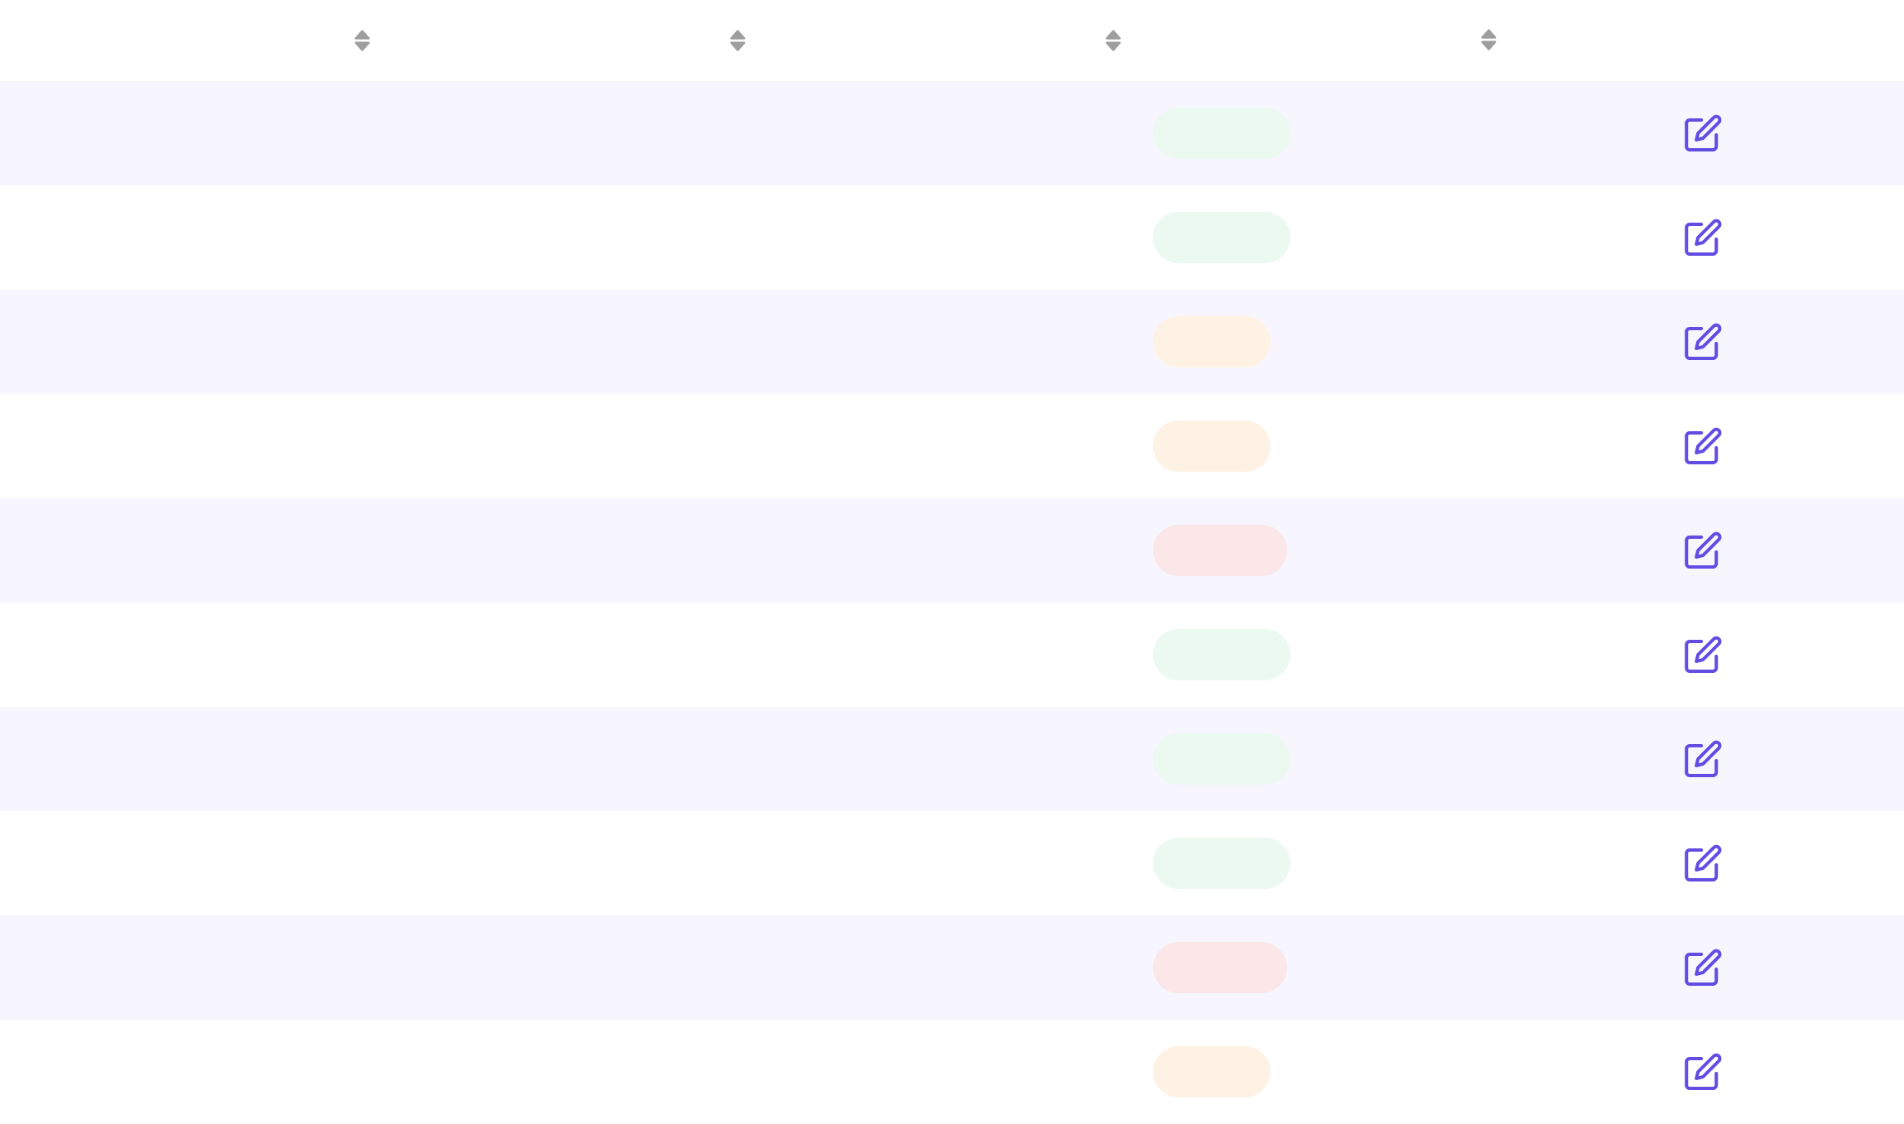

Home
Catalog
Resources
Designer
My Account
Join Designer
Dave Smith
Create Vendor
Favorites
Display Name
Edit
DaveSmith123
Data & Privacy
Contact Email
Edit
Log Out
save.smith@davemail.com
My Current Designs
Show
10
entries
Search...
Add Design
Product
Start Date
End Date
Status
Action
Hat
13/05/2022
13/05/2022
Delivered
Laptop
22/05/2022
13/05/2022
Delivered
Phone
15/06/2022
13/05/2022
Process
Bag
06/09/2022
13/05/2022
Process
Headset
25/09/2022
13/05/2022
Canceled
Mouse
04/10/2022
13/05/2022
Delivered
Clock
17/10/2022
13/05/2022
Delivered
T-shirt
24/10/2022
13/05/2022
Delivered
Monitor
01/11/2022
13/05/2022
Canceled
Keyboard
22/11/2022
13/05/2022
Process
© 2022 COMPANY NAME
1
2
3
Next
By accessing this page, you agree to the Terms.

Slide 9




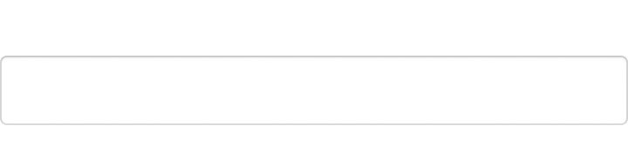

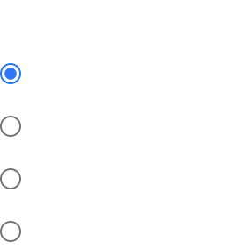
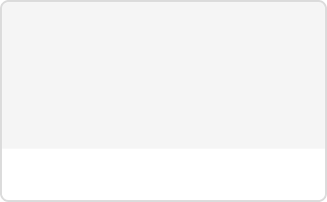
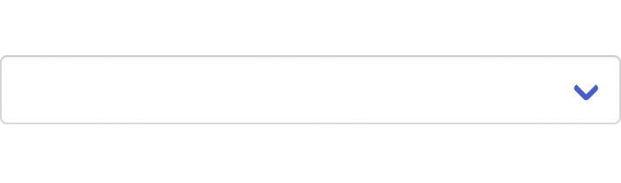

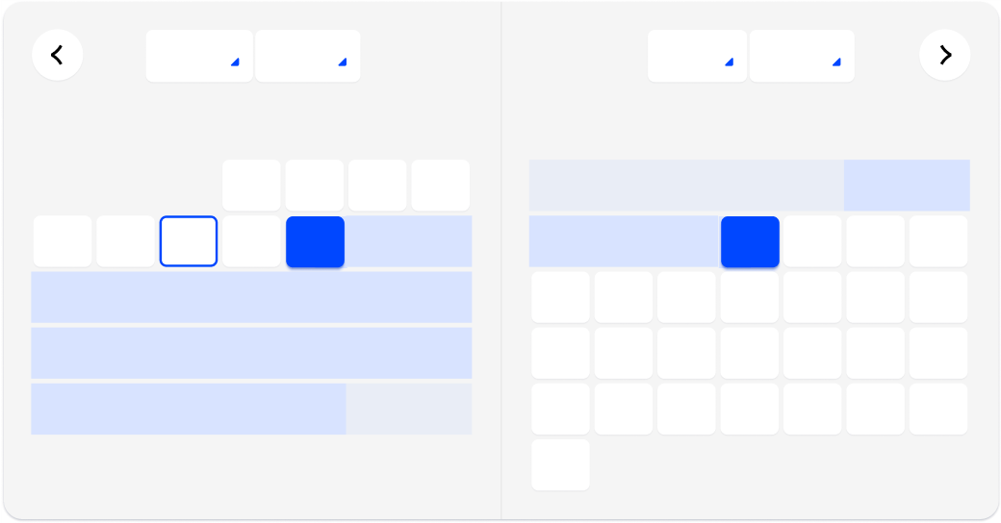

Home
Catalog
Resources
Vendor Settings
>
Creating new Item
1
Create Item
2
Set Images
3
Publish
Create an item!
Preview
Label
Banner
Current Status
Interest Check
John Doe
upload
Interest Check
Choose a file...
Group Buy
Label
Screen Shot 2017 07 29 at 15.54.25.png
Production
Designer Id
Delivering
Label
Select Regions
This is a help text
Start/End Time
Mo
Tu
April
2021
May
2021
29
30
We
Th
Fr
Sa
Su
Mo
Tu
We
Th
Fr
Sa
Su
5
6
31
1
2
3
4
26
27
28
29
30
1
2
12
13
7
8
9
10
11
3
4
5
6
7
8
9
19
20
14
15
16
17
18
10
11
12
13
14
15
16
26
27
21
22
23
24
25
17
18
19
20
21
22
23
28
29
30
1
2
24
25
26
27
28
29
30
31
1
2
3
4
5
6
Next
© 2022 COMPANY NAME
By accessing this page, you agree to the Terms.

Slide 10
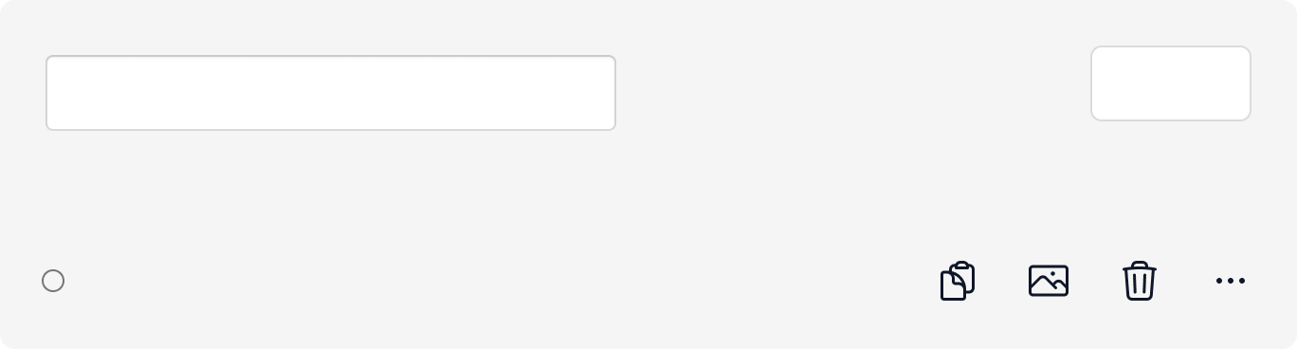
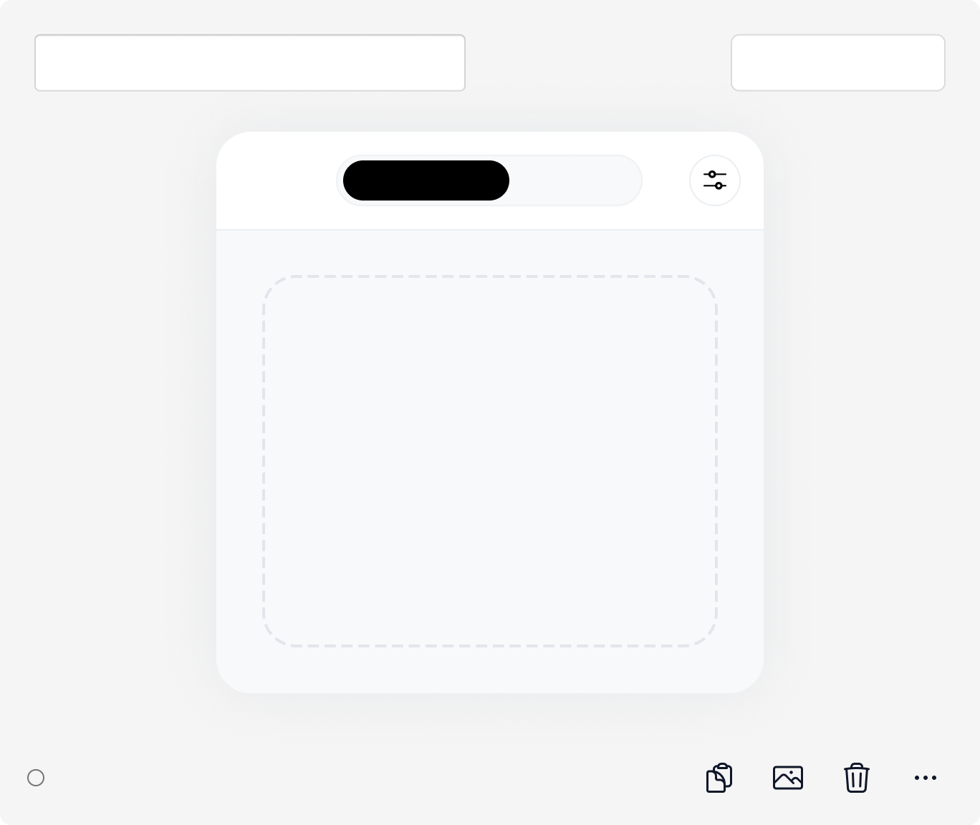
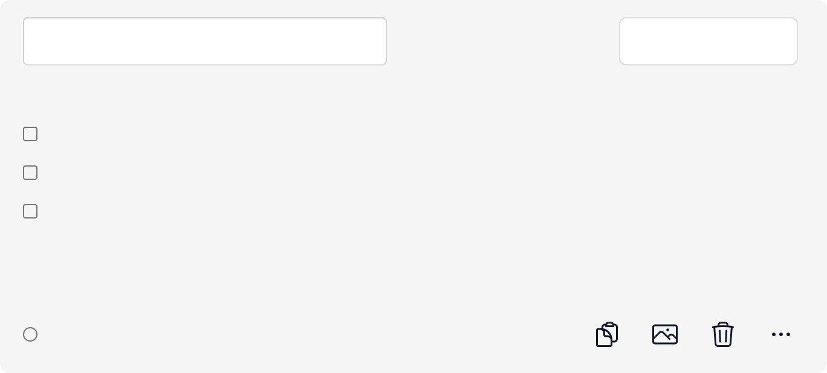
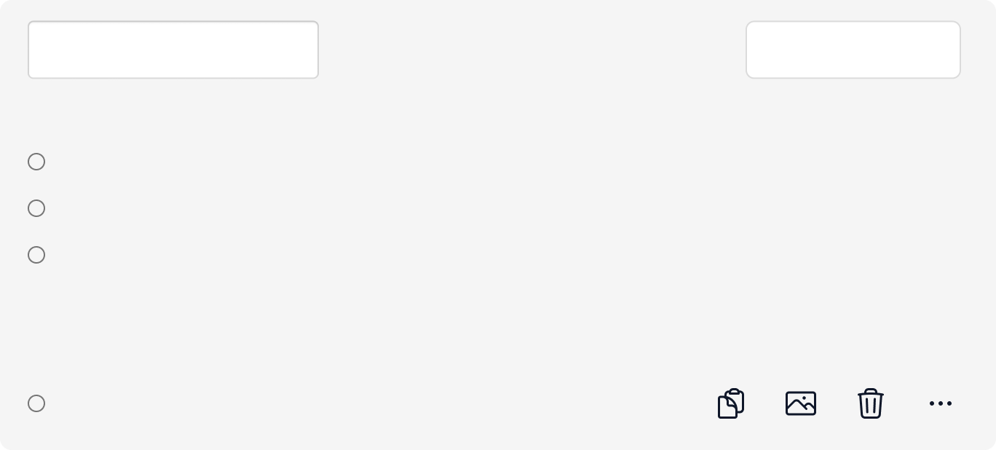

Home
Catalog
Resources
Vendor Settings
>
Creating new Item
Create an Interest Form
Preview
Form
Analytics
Settings
Text input
Text
chevron-down
Required
Text input
Multi Image
chevron-down
New Upload
Recent
Click to browse or drag and drop your files
Required
Text input
Multi Check
chevron-down
Checkbox
Checkbox
Checkbox
Add another or add “Other”
Required
Text input
Multi Check
chevron-down
Radio button
Radio button
Radio button
Add another or add “Other”
Required
Save & Publish
© 2022 COMPANY NAME
By accessing this page, you agree to the Terms.

Slide 11


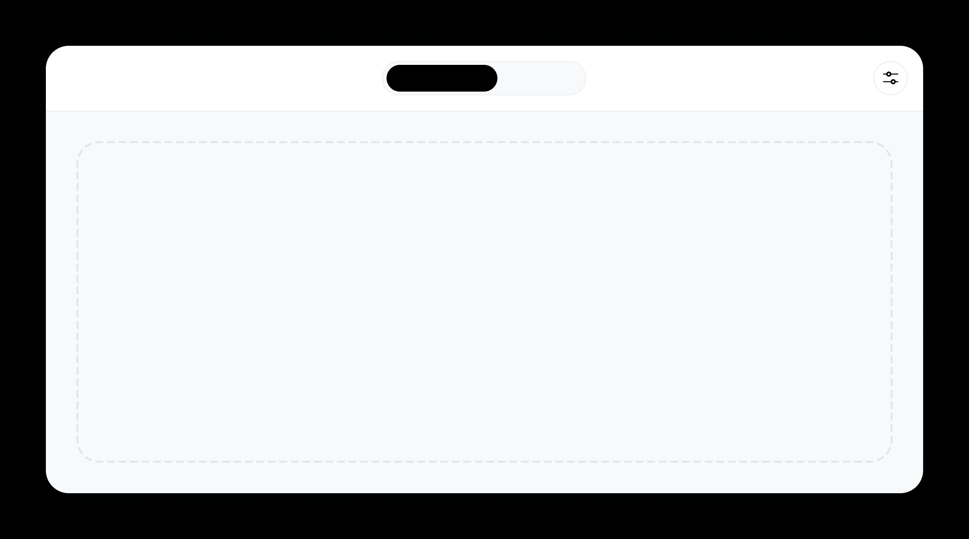

Home
Catalog
Resources
Vendor Settings
>
Creating new Item
1
Create Item
2
Set Images
3
Publish
Add Images
Preview
Main Banner
upload
Choose a file...
Screen Shot 2017 07 29 at 15.54.25.png
Add kit images
New Upload
Recent
Click to browse or drag and drop your files
Next
© 2022 COMPANY NAME
By accessing this page, you agree to the Terms.

Slide 12
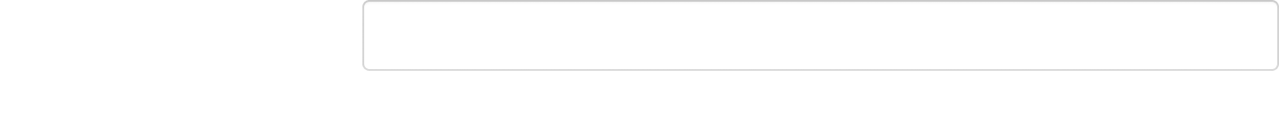
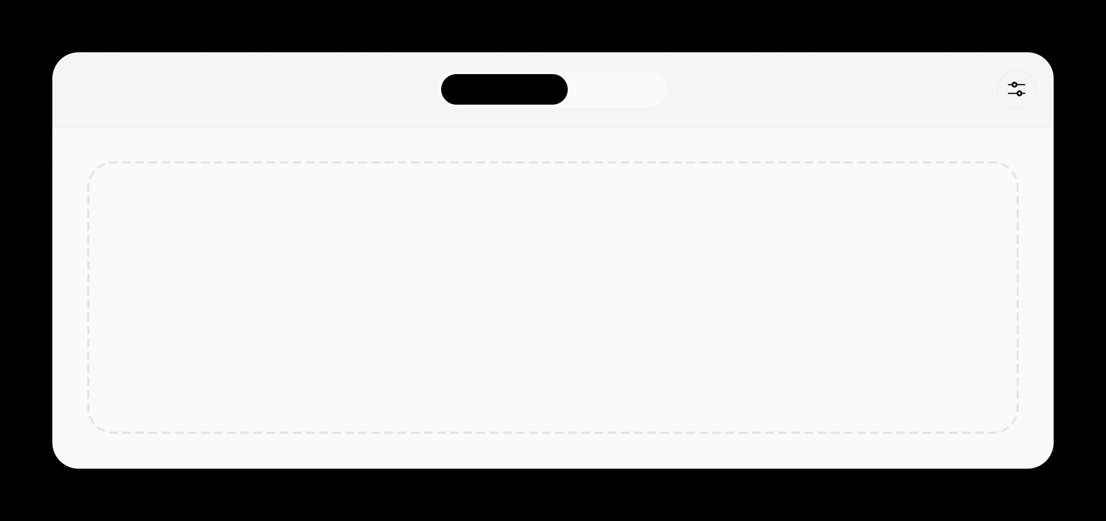

Home
Catalog
Resources
Vendor Settings
>
Creating new Item
1
Create Item
2
Set Images
3
Publish
Get ready for the next big thing!
Preview
Tags
ABS, GMK, Etc.
This helps out users find your item by key words.
Select the cover image
New Upload
Recent
Click to browse or drag and drop your files
Next
© 2022 COMPANY NAME
By accessing this page, you agree to the Terms.

Slide 13

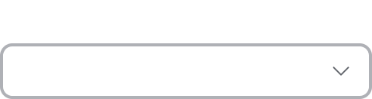

Home
Catalog
Resources
Favorites
My Account
Join Designer
Create Vendor
Visibility
Favorites
Visibility
Friends
Friends
Data & Privacy
Log Out
My Favorites
Product Name
Product Name
Product Name
Product Name
2022
2022
2022
2022
Product Name
Product Name
Product Name
Product Name
2022
2022
2022
2022
© 2022 COMPANY NAME
By accessing this page, you agree to the Terms.

Slide 14








Home
Catalog
Resources
My Account
My Account
Join Designer
Dave Smith
Create Vendor
Favorites
Display Name
Edit
DaveSmith123
Name
Edit
Dave Smith
Email
Edit
save.smith@davemail.com
Password
Change
*******************
Data & Privacy
Log Out
Connected
Connected
Connect
© 2022 COMPANY NAME
By accessing this page, you agree to the Terms.

Slide 15

Nimbus
2 of 9
Which kit(s) are you interest in?
SKIP
Next
© 2022 COMPANY NAME
By filling this form, you agree to the Terms.

Slide 16
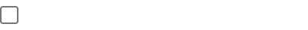

Nimbus
3 of 9
This form has check-boxes
Yes
No
I hate this set
SKIP
Next
© 2022 COMPANY NAME
By filling this form, you agree to the Terms.

